Slide 1


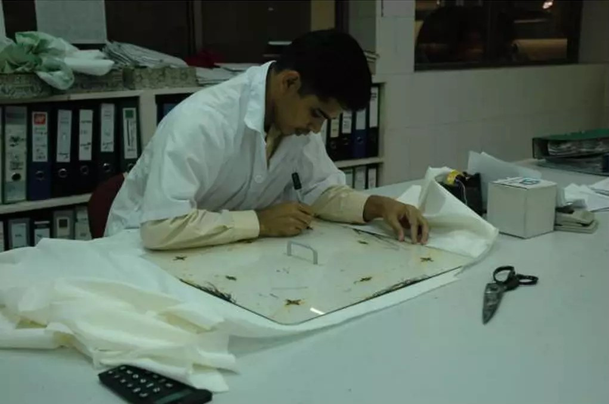

FABRIC INSPECTION BASED ON SHRINKAGE

Slide 2



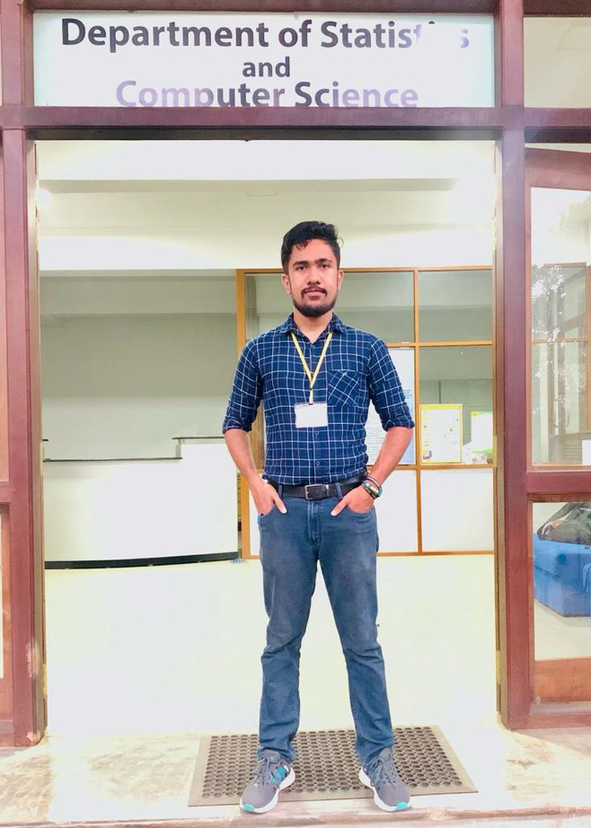




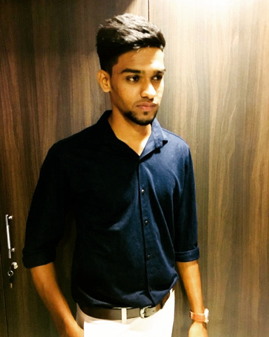
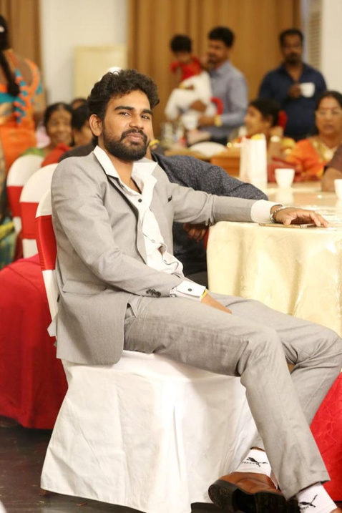
Our Team
Kareendra Jayasankha
Janith Dakshitha
Shankara Devapriya
Nipuni madumali
Remy
Marsh
Manager
Marketing
Business Head
Sandali kavindi
yoganatan
shakiraj
Julion Mathuharan
Julion Mathuharan

Slide 3
Content
1
Company Overview
2
Major Challenge
3
Expected Solutions
4
Timeline
5
Algorithm
6
Setup
7
Code Implementation
8
Analyze Data
9
Conclusion
10
Challenges Faced

Slide 4





Company Overview
The largest apperal manufacture company in Sri Lanka
01
Manufacturing presence in India and Bangladesh
Delivering Innovative Solutions to Global Brands for 50 Years.
02
03
There are 60,000+ number of employees currently working

Slide 5




Major
Challenge
Manual measurement in the shrinkage testing process introduces the potential for human error, leading to inaccurate results.

Slide 6


Expected Solutions
Ensure that quality is maintained.
Robust system where the Inspection Process is done as efficiently as possible
Less human intervention and a more automated and systematic approach
Use the latest technology and market trends

Slide 7

TIMELINE
These are the key days of Our project

Slide 8





4th Quarter
Final Presentation
3rd Quarter
Timeline
The team members gathered and engaged in discussions with a Brandix liaison.
2nd Quarter
Mid Review
1st Quarter
Site tour of Brandix's main office and arrange discussion with team members

Slide 9

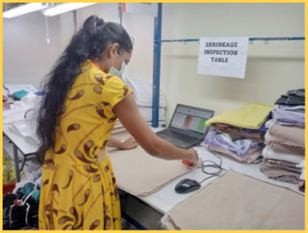
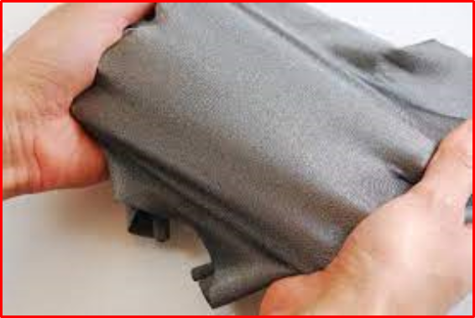
Shrinkage
Shrinkage of cloth refers to the reduction in size of a piece of fabric after washing, dying of fabric procedure and when exposed to the relaxing of fabric.

Slide 10




WHAT THEY DO
Introduce the company's main process about the shrinkage
STAGE 1
STAGE 2
STAGE 3
For all the fabric, we first perform the residual shrinkage, which entails unrolling the fabric in layers and allowing it to relax for 24 hours to mitigate the tension within the fabric roll.
Take a 1-yard cloth piece from each roll, including the batch and roll numbers.
Mark 8 points on the fabric piece using a textile pen and a standard shrinkage board. Measurements are automatically updated in Excel via a Bluetooth tape device.
Send the fabric for wash and dye, let it dry, and then check the distance between the marked points using the Bluetooth tape.

Slide 11
ALGORITHM
step by step process

Slide 12

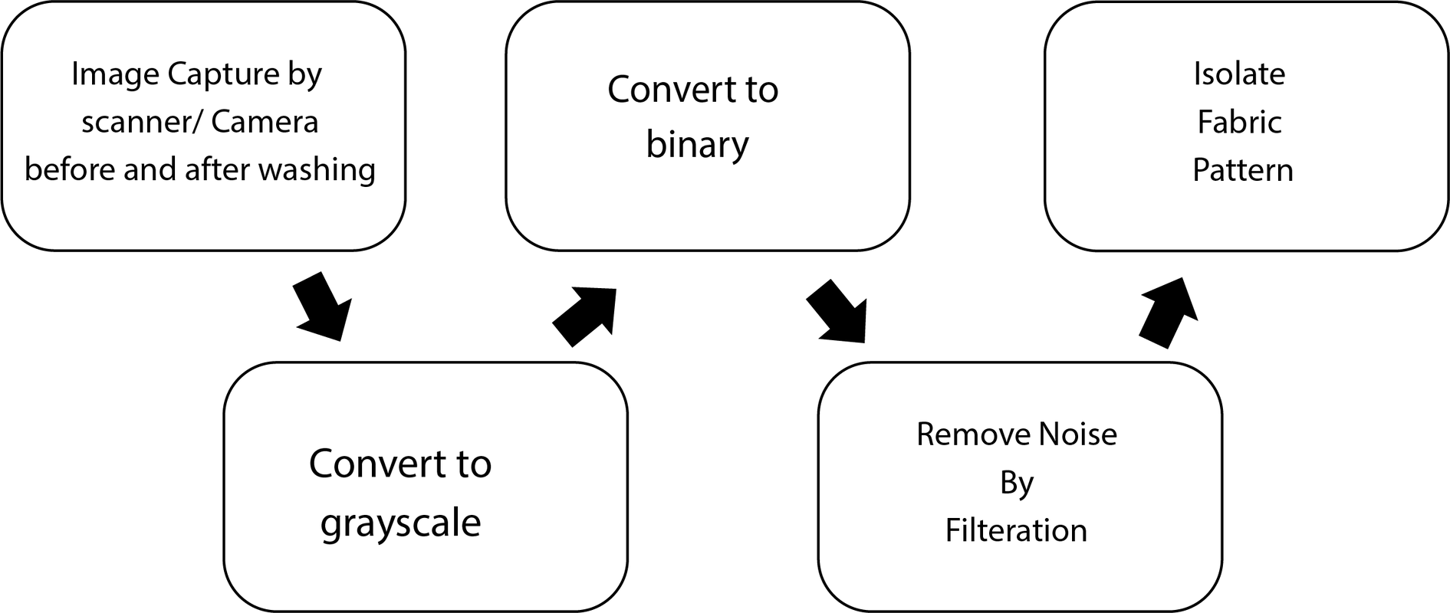
Algorithm

Slide 13
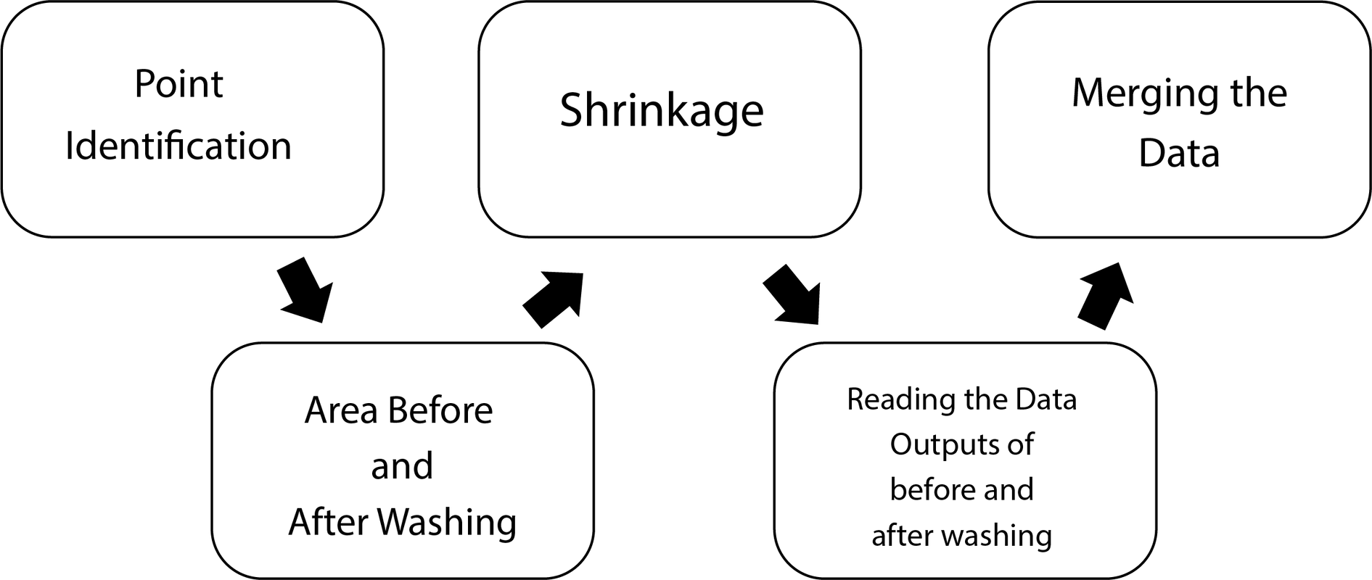

Slide 14
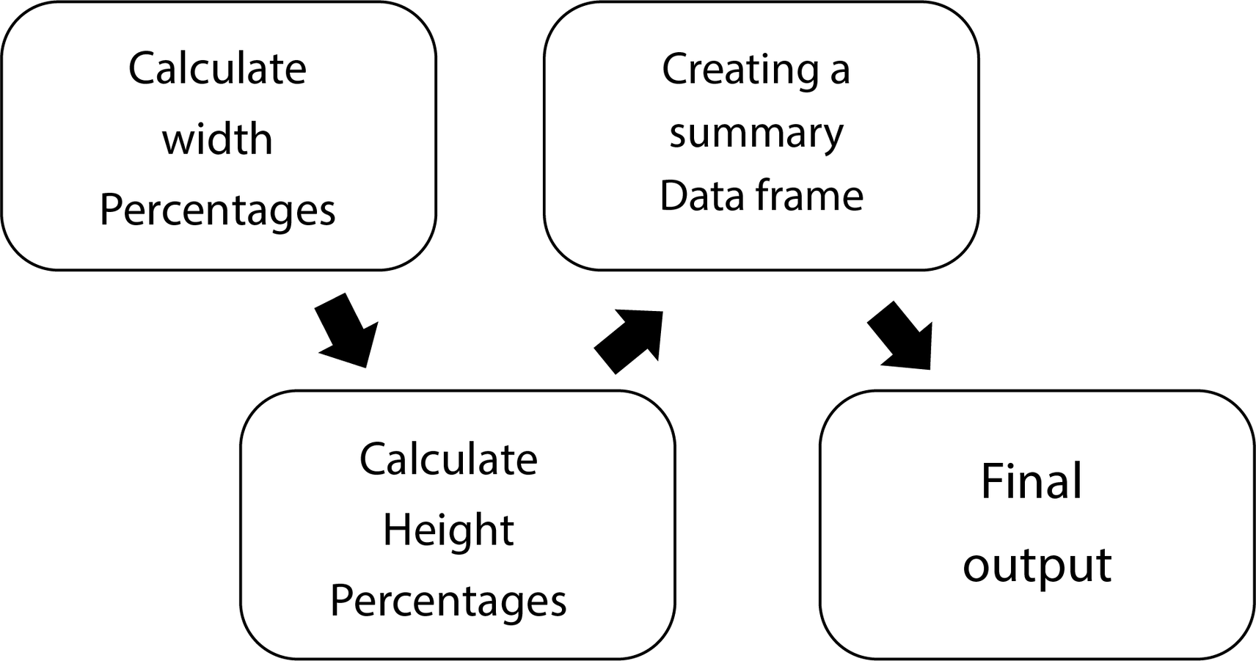

Slide 15
SETUP
process of building the setup

Slide 16
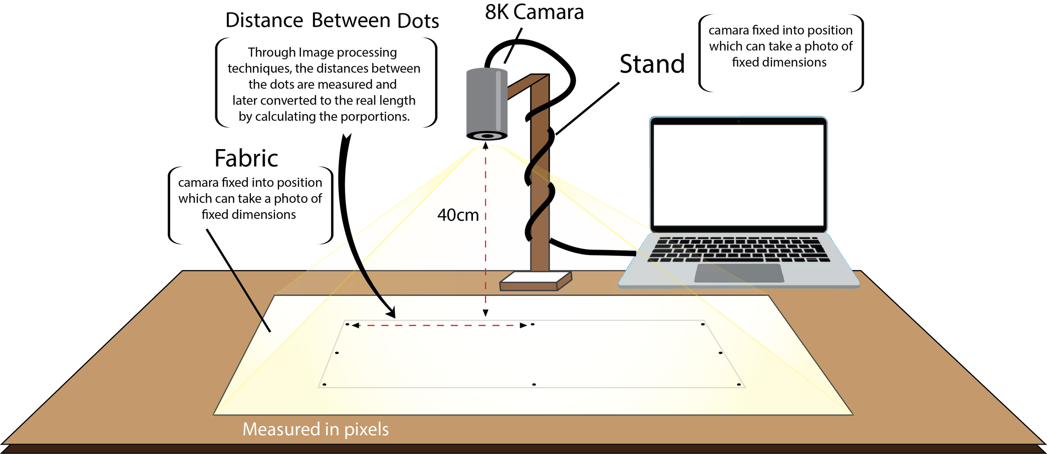
General Build

Slide 17
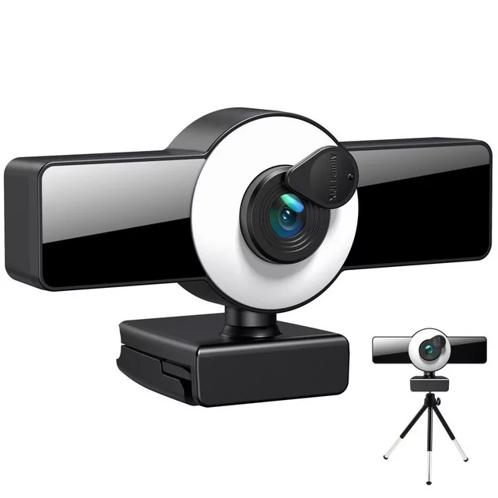
Camera Selection
8K FullHD High Definition Webcam
Autofocus Technology
Ease of Use
Real-Time Preview

Slide 18
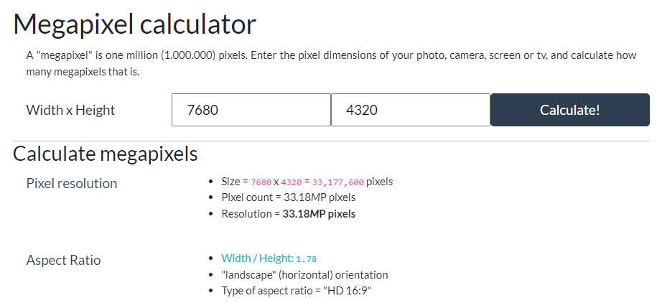
Resolution

Slide 19
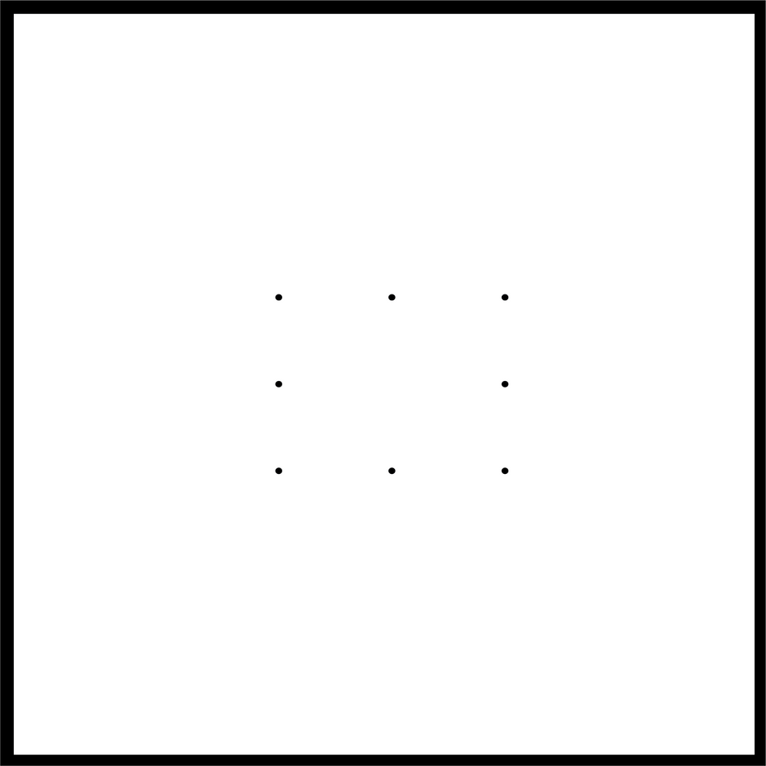
Process
40cm x 40cm piece of fabric from the fabric roll.
The dimensions of the apparatus is 45cm X 45cm.
Mark the 8 points.
We are capturing the image of the fabric with each roll before and after wash, then using Python we can generate the distances and area of the dots in the fabric.
As for the future developments we can create an interface to connect the setup with Python and R to display the final excel output.

Slide 20
Weaknesses
Limited Focus Range
Low Image Quality
Limited Manual Controls
Shutter Lag
Low Light Performance

Slide 21


Evolution in IOT

Slide 22
CODE IMPLEMENTATION
Coding process

Slide 23


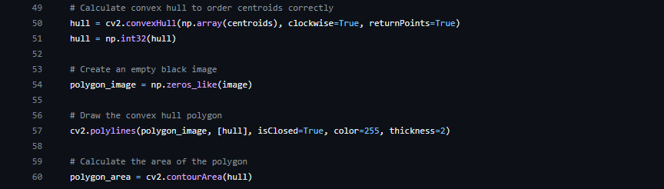
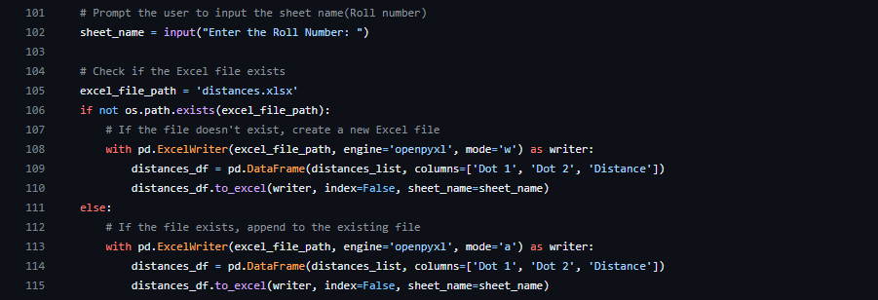

1) Included packages
Image Processing
2) Image Capture
With python using the Open CV library
We have decided to measure the distance
between the dots
by processing the image
using python.
3) Drawing the Polygon
4) Exporting to Excel

Slide 24




Image Processing
Input : Image
Fabric with patterns
Fabric with different colors
Fabric with different materials

Slide 25
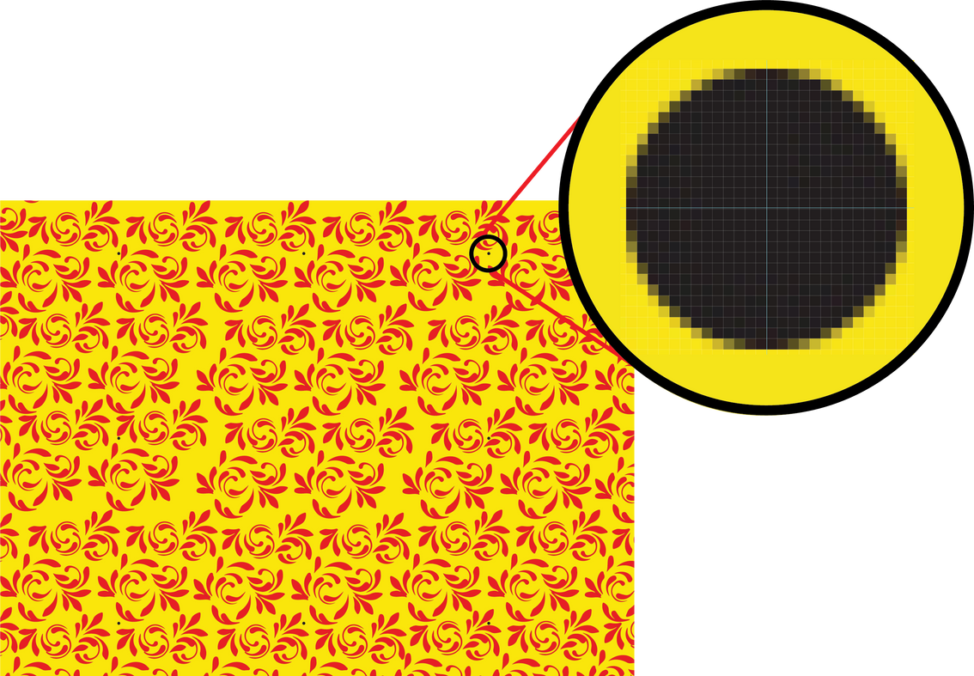
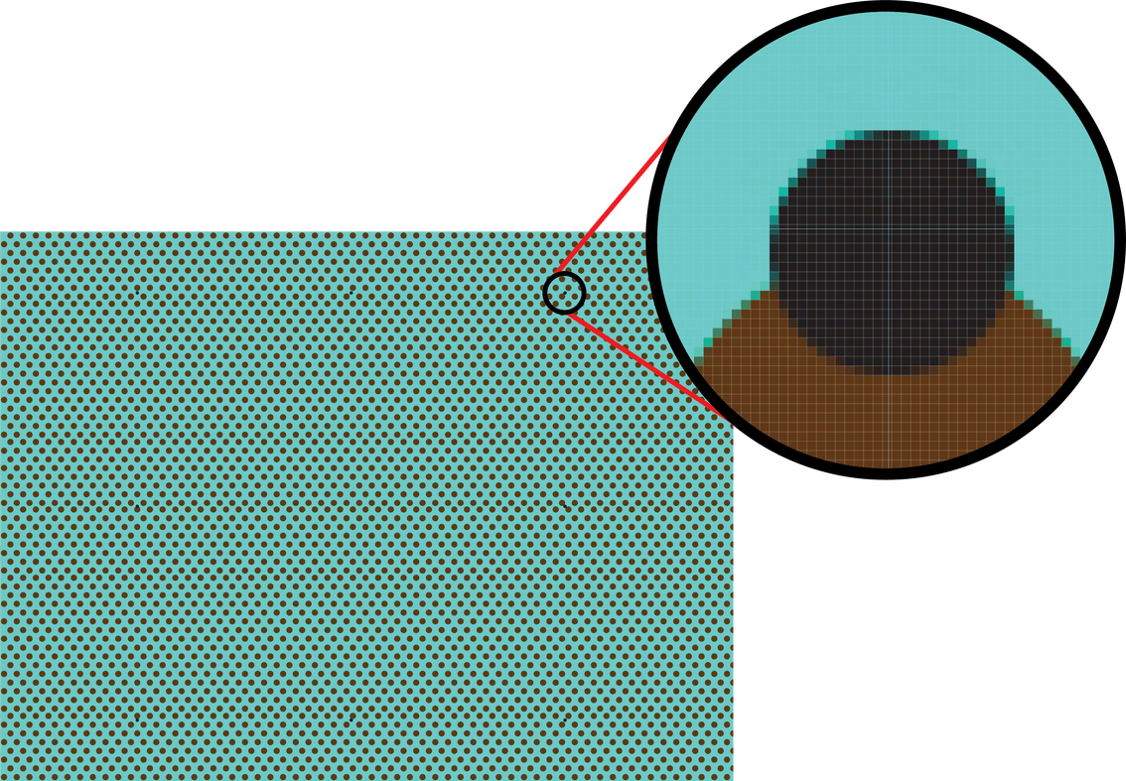
Image Processing
Point Identification
According to the size
According to the color
Number of squre pixels
Color range of the marker dot

Slide 26
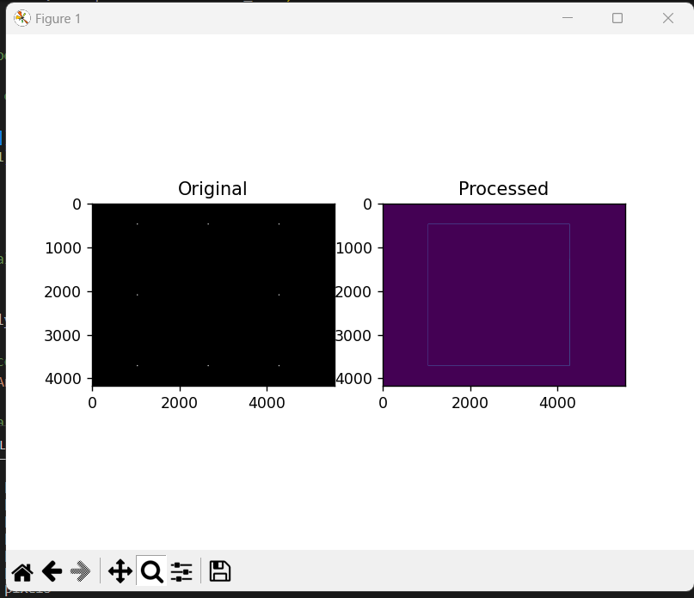
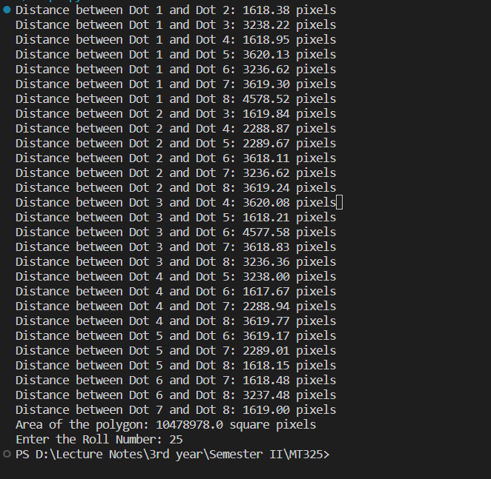
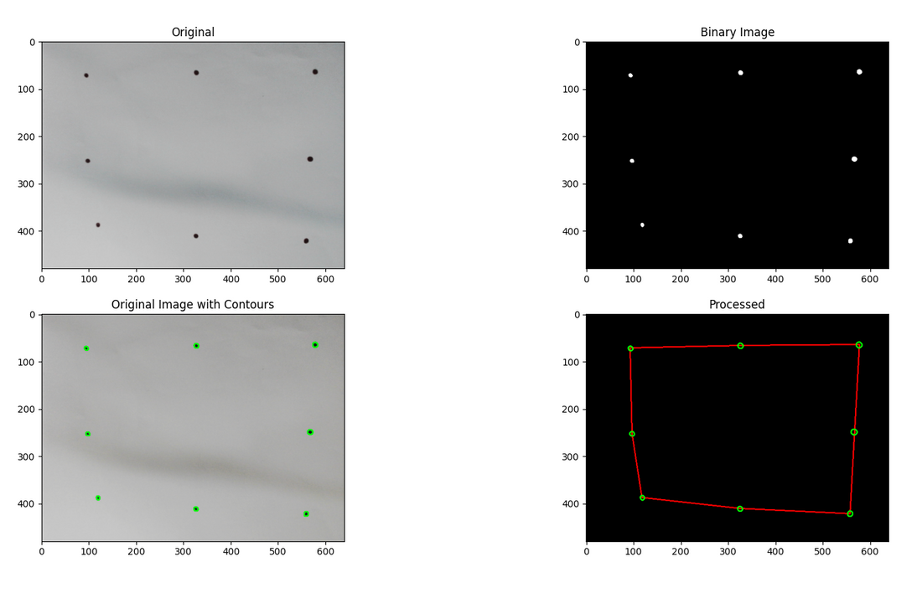
Output:

Slide 27
ANALYSIZING
Calculating the Shrinkage of Each
Fabric using R & Excel

Slide 28
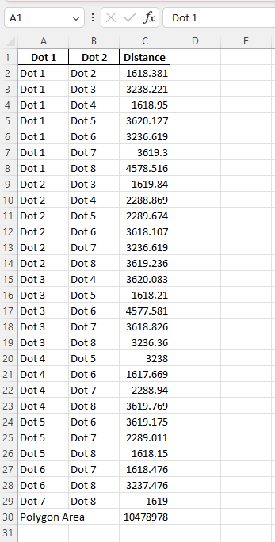
Dataset of before washing

Slide 29
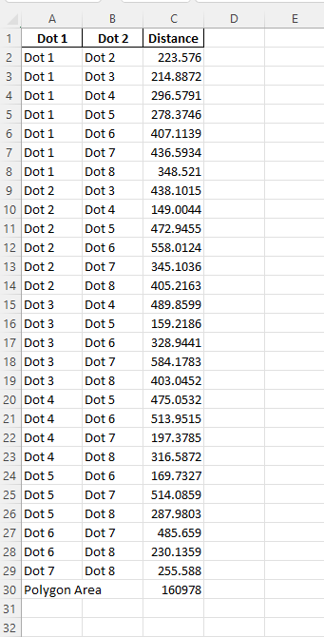
Dataset of after washing

Slide 30
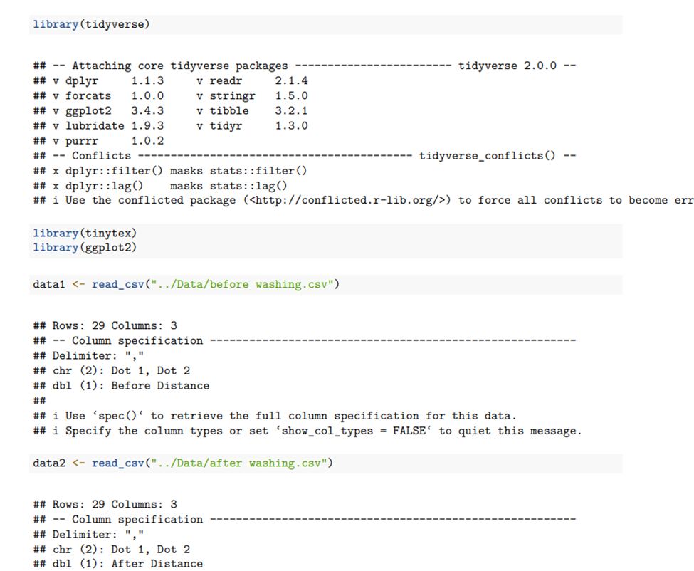
Analysis Using R

Slide 31
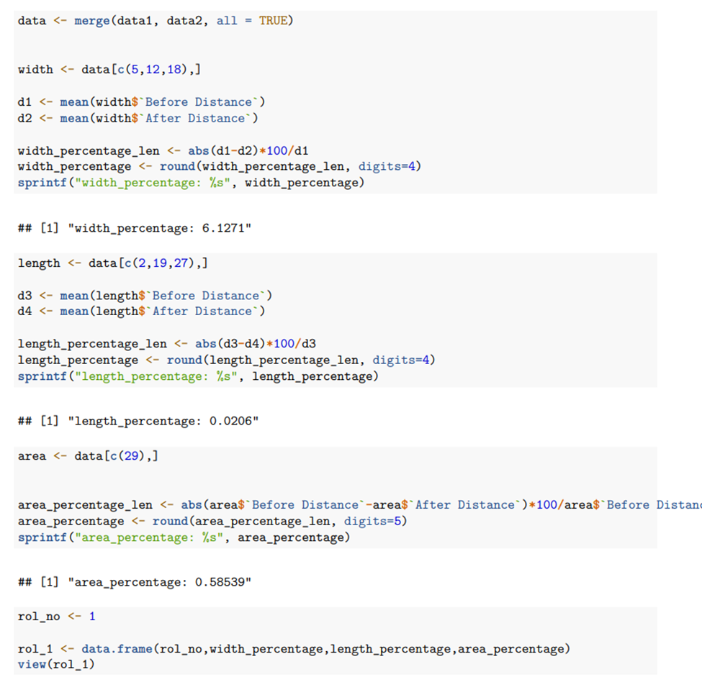
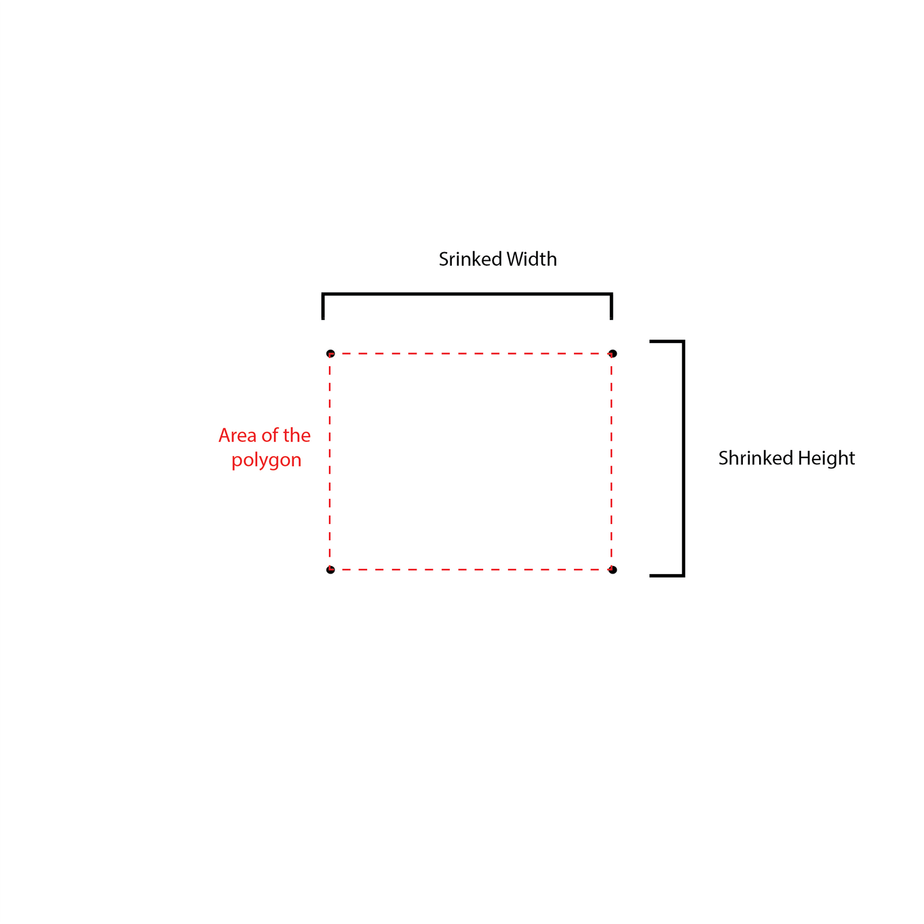
Analysis Using R

Slide 32
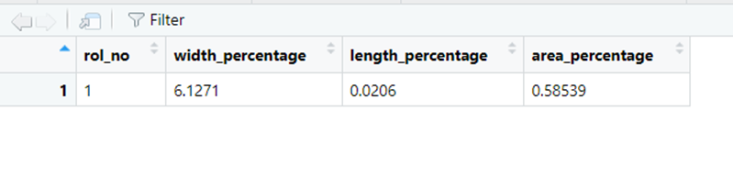
Final Output

Slide 33

Conclusions
01
Successful Image Processing Implementation
02
Shrinkage Percentage Calculation
03
Excel Integration for Data Management
04
Industry Adoption

Slide 34



Data Annotation Challenges
Image Variability and Noise
Difficulties
Faced
Dot Identification Accuracy
Finding Equipment

Slide 35

THANK YOU

